Slide 1
Chapter 4
Benefit/Cost Analysis

Slide 2
LEARNING OUTCOMES
Explain difference in public vs. private sector projects
Calculate B/C ratio for single project
Select better of two alternatives using B/C method
Select best of multiple alternatives using B/C method
Use cost-effectiveness analysis (CEA) to evaluate service sector projects
6. Describe how ethical compromises may enter public
sector projects
© 2012 by McGraw-Hill All Rights Reserved
9-<number>

Slide 3
Pubic sector projects
A public sector project is a product, service, or system used, financed, and owned by the citizens of any government level.
The primary purpose is to provide service to the citizenry for the public good at no profit.
Areas such as public health, criminal justice, safety, transportation, welfare, and utilities are publically owned and require economic evaluation.
© 2012 by McGraw-Hill, New York, N.Y All Rights Reserved
1-<number>

Slide 4
Differences: Public vs. Private Projects
Characteristic Public Private
Size of Investment Large Small, medium, large
Life Longer (30 – 50+ years) Shorter (2 – 25 years)
Annual CF No profit Profit-driven
Funding Taxes, fees, bonds, etc. Stocks, bonds, loans, etc.
Interest rate Lower Higher
Selection criteria Multiple criteria Primarily ROR
Environment of evaluation Politically inclined Economic
© 2012 by McGraw-Hill All Rights Reserved
9-<number>

Slide 5
Types of Contracts
  Most of the large public sector projects are developed through PPPs.
  Reasons: Greater efficiency of private sector and the sizable cost to design, construct, and operate where full funding by the govt. may not be possible using fees, taxes, and bonds.
  Types of PPPs
  Design-build projects - Contractor responsible from design stage to operations stage
  Design-build-operate-maintain-finance (DBOMF) projects - Turnkey project with contractor managing financing (manage cash flow); government obtains funding for project
  DBOM- When the financing activity is not managed by a contractor, the contractor is a DBOM.
  PPP examples: Construction of Dhaka Elevated Expressway
  Private Partner: Italian-Thai Development Company Ltd (International)
© 2012 by McGraw-Hill All Rights Reserved
9-<number>

Slide 6
Cash Flow Classifications
Costs—estimated expenditures to the government entity for construction, operation, and maintenance of the project, less any expected salvage value
Benefits—advantages to be experienced by the owners, the public.
Disbenefits—expected undesirable or negative consequences to the owners if the alternative is implemented. Disbenefits may be indirect economic disadvantages of the alternative.
Note: Savings to government are subtracted from costs
© 2012 by McGraw-Hill, New York, N.Y All Rights Reserved
1-<number>

Slide 7
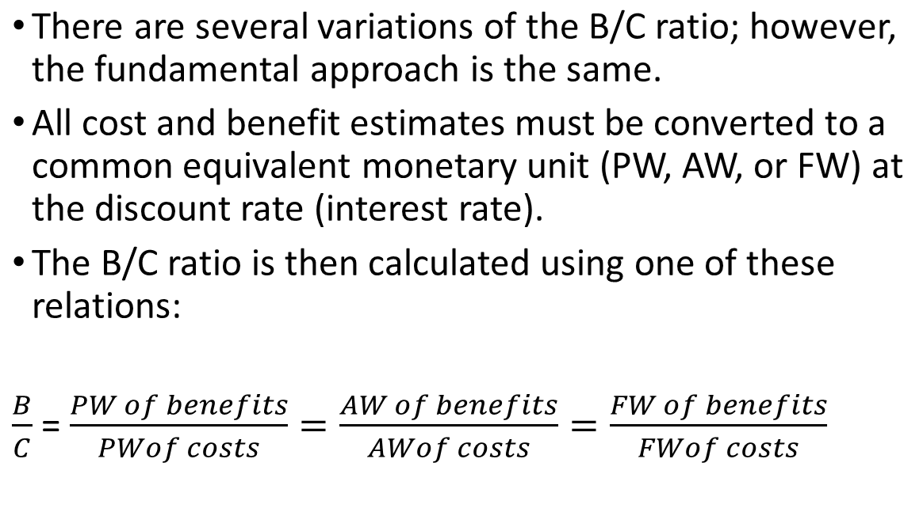

Benefit/Cost Analysis of a Single Project
1-<number>

Slide 8
Benefit/Cost Analysis of a Single Project
The decision guideline is simple:
If B/C ≥ 1.0, accept the project as economically justified for the estimates and discount rate applied.
If B/C < 1.0, the project is not economically acceptable.
If the B/C value is exactly or very near 1.0, noneconomic factors will help make the decision.
1-<number>

Slide 9
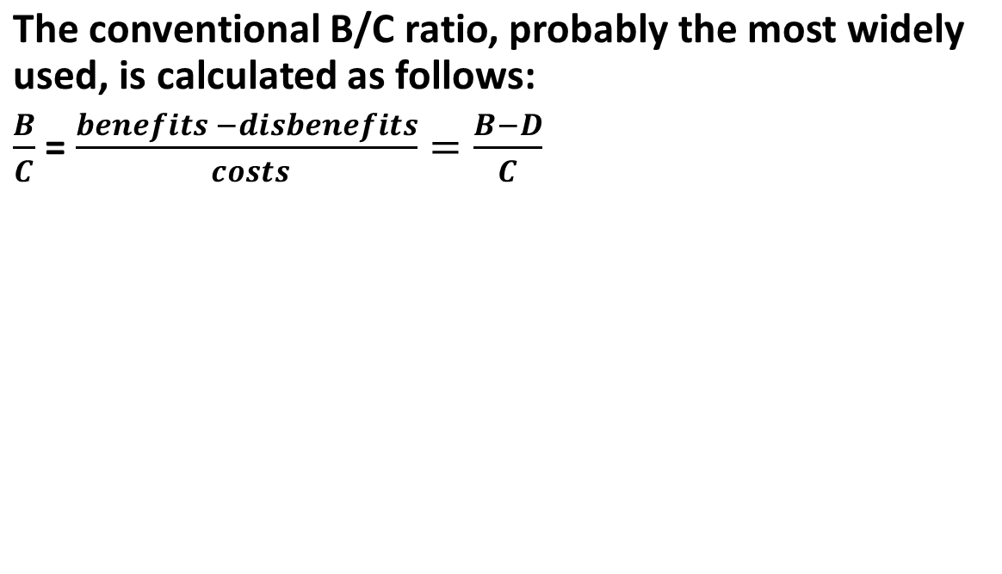
Benefit/Cost Analysis of a Single Project
Disbenefits are subtracted from benefits, not added to costs. The B/C value could change considerably if disbenefits are regarded as costs.
However, regardless of whether disbenefits are (correctly) subtracted from the numerator or (incorrectly) added to costs in the denominator, a B/C ratio of less than 1.0 by the first method will always yield a B/C ratio less than 1.0 by the second method, and vice versa.
1-<number>

Slide 10
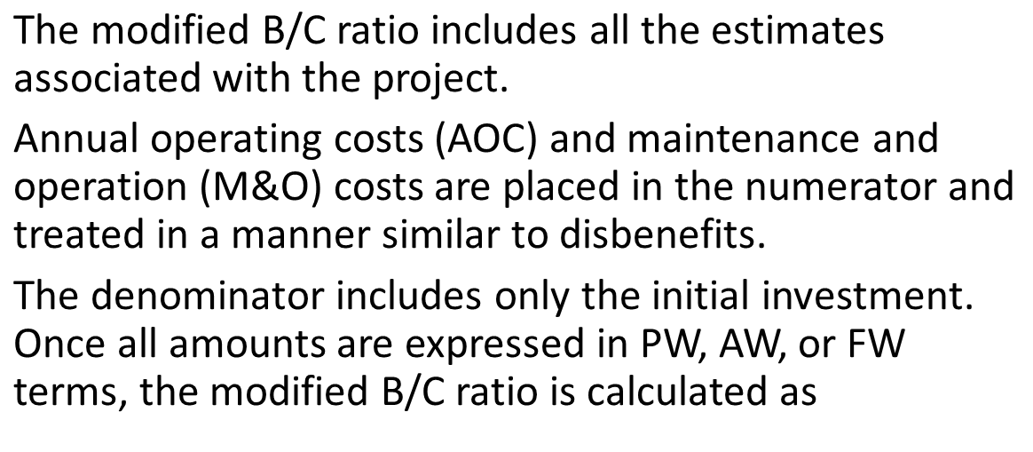
Benefit/Cost Analysis of a Single Project
1-<number>

Slide 11
Benefit/Cost Analysis of a Single Project
Salvage value is usually included in the denominator as a negative cost.
The modified B/C ratio will obviously yield a different value than the conventional B/C method.
However, as with disbenefits, the modified procedure can change the magnitude of the ratio but not the decision to accept or reject the project.
The decision guideline for the modified B/C ratio is the same as that for the conventional B/C ratio.
© 2012 by McGraw-Hill, New York, N.Y All Rights Reserved
1-<number>

Slide 12
Defender, Challenger and Do Nothing Alternatives
When selecting from two or more ME alternatives, there is a:
Defender – in-place system or currently selected alternative
Challenger – Alternative challenging the defender
Do-nothing option – Status quo system
© 2012 by McGraw-Hill All Rights Reserved
9-<number>

Slide 13
Incremental B/C Analysis (Two Alternatives)
The incremental (conventional) B/C ratio, which is identified as ΔB/C, is determined using PW, AW, or FW calculations. The higher-cost alternative is justified if ΔB/C is equal to or larger than 1.0. The selection rule is as follows:
The selection rule is as follows
If ΔB/C ≥ 1.0, choose the higher-cost alternative, because its extra cost is economically justified.
If ΔB/C < 1.0, choose the lower-cost alternative.
© 2012 by McGraw-Hill, New York, N.Y All Rights Reserved
1-<number>

Slide 14
Incremental B/C Analysis (Two Alternatives)
To correctly perform a conventional B/C ratio analysis of two alternatives. Equivalent values can be expressed in PW, AW, or FW terms.
Determine the equivalent total costs for both alternatives.
Order the alternatives by equivalent total cost: first smaller, then larger. Calculate the incremental cost (ΔC) for the larger-cost alternative. This is the denominator in ΔB/C.
3. Calculate the equivalent total benefits and any disbenefits estimated for both alternatives. Calculate the incremental benefits (ΔB) for the larger-cost alternative. This is Δ(B − D) if disbenefits are considered.
4. Calculate the ΔB/C ratio using Equation [9.2], (B − D)/C. 5.
5. Use the selection guideline to select the higher-cost alternative if ΔB/C ≥ 1.0.
1-<number>

Slide 15
B/C Analysis – Single Project
B - D
Conventional B/C ratio =
C
If B/C ≥ 1.0,
accept project;
otherwise, reject
B – D – M&O
Modified B/C ratio =
C
PW of NCF_{t}
Denominator is
initial investment
PI =
PW of initial investment
If PI ≥ 1.0,
accept project;
otherwise, reject
© 2012 by McGraw-Hill All Rights Reserved
9-<number>

Slide 16
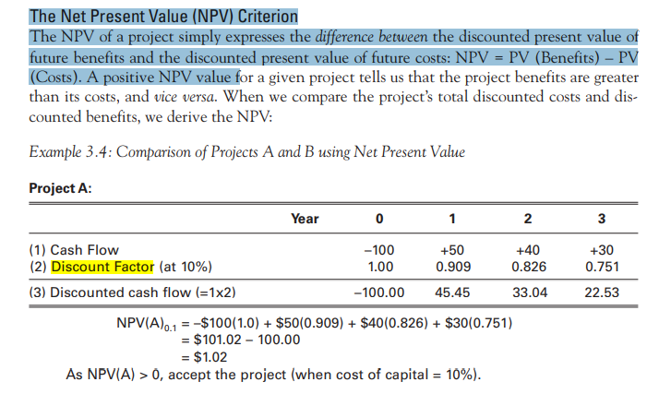
Decision rules-the Net Present Value(NPV)
© 2012 by McGraw-Hill, New York, N.Y All Rights Reserved
1-<number>

Slide 17
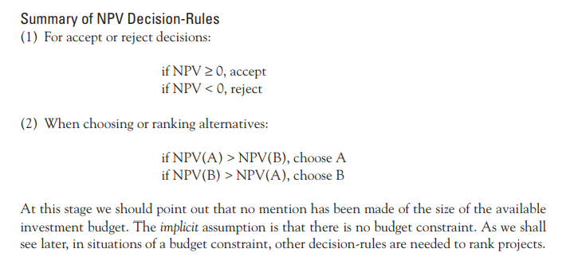
Decision rules-the Net Present Value(NPV)
© 2012 by McGraw-Hill, New York, N.Y All Rights Reserved
1-<number>

Slide 18
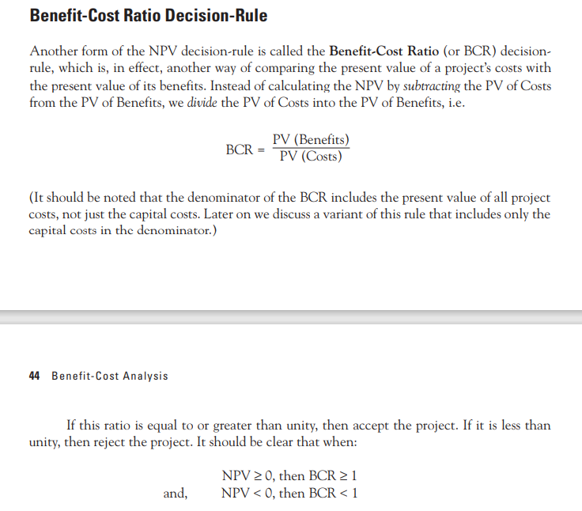
Decision rules: Benefit-Cost Ration
1-<number>

Slide 19
Decision rules: The Internal Rate of Return (IRR) Criterion
The discount rate at which the NPV becomes “0” is called the Internal Rate of Return (IRR).
Once we know the IRR of an investment we can compare this with the cost of financing our project.
In a project, the IRR was found to lie between 20 and 25%, approximately 23%. Let us say, in this case, the cost of financing the project is 15%. Now, as the rate of return, the IRR, is greater than the cost of financing the project, we should accept the investment.
In fact, in the case of this investment, we would accept the investment at any cost of finance that is below 23%. When the IRR is less than the cost of finance, the project should be rejected
1-<number>

Slide 20

Decision rules: The Internal Rate of Return (IRR) Criterion
When considering an individual project, the IRR decision-rule will always give exactly the same result as the NPV decision-rule:
1-<number>

Slide 21
Example: B/C Analysis – Single Project
A flood control project will have a first cost of $1.4 million with an annual
maintenance cost of $40,000 and a 10 year life. Reduced flood damage is
expected to amount to $175,000 per year. Lost income to farmers is estimated
to be $25,000 per year. At an interest rate of 6% per year, should the
project be undertaken?
Solution: Express all values in AW terms and find B/C ratio
B = $175,000
D = $25,000
C = 1,400,000(A/P,6%,10) + $40,000 = $230,218
B/C = (175,000 – 25,000)/230,218
= 0.65 < 1.0
Do not build project
© 2012 by McGraw-Hill All Rights Reserved
9-<number>

Slide 22
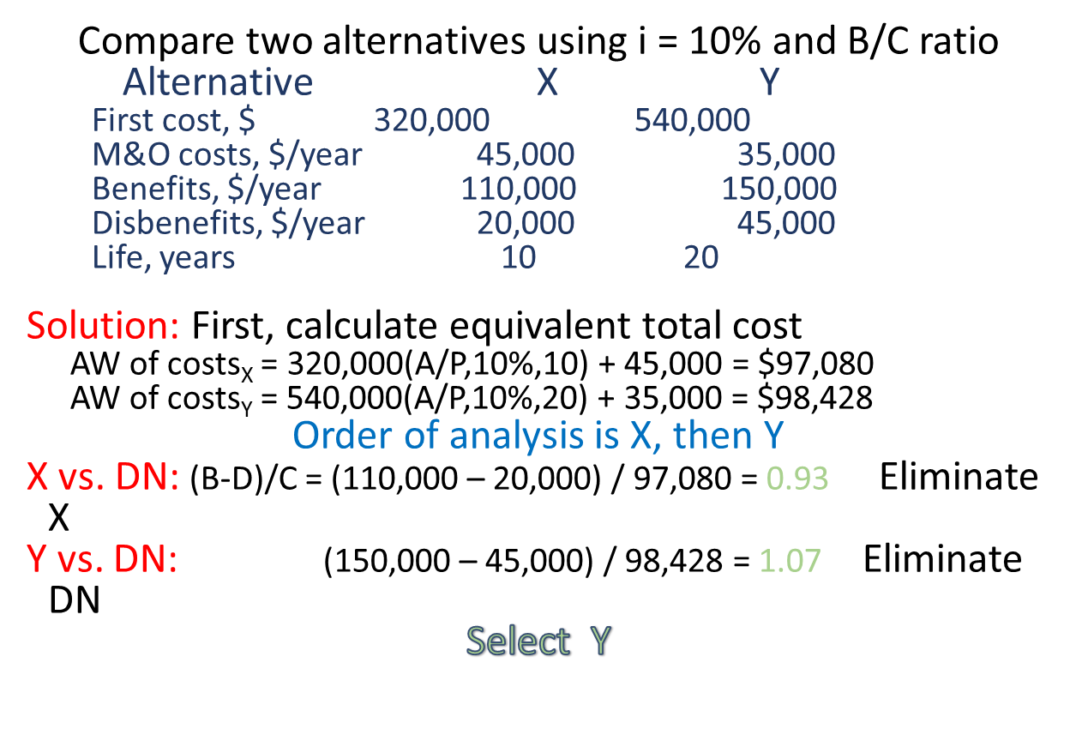
Example: Incremental B/C Analysis
9-<number>
© 2012 by McGraw-Hill All Rights Reserved

Slide 23
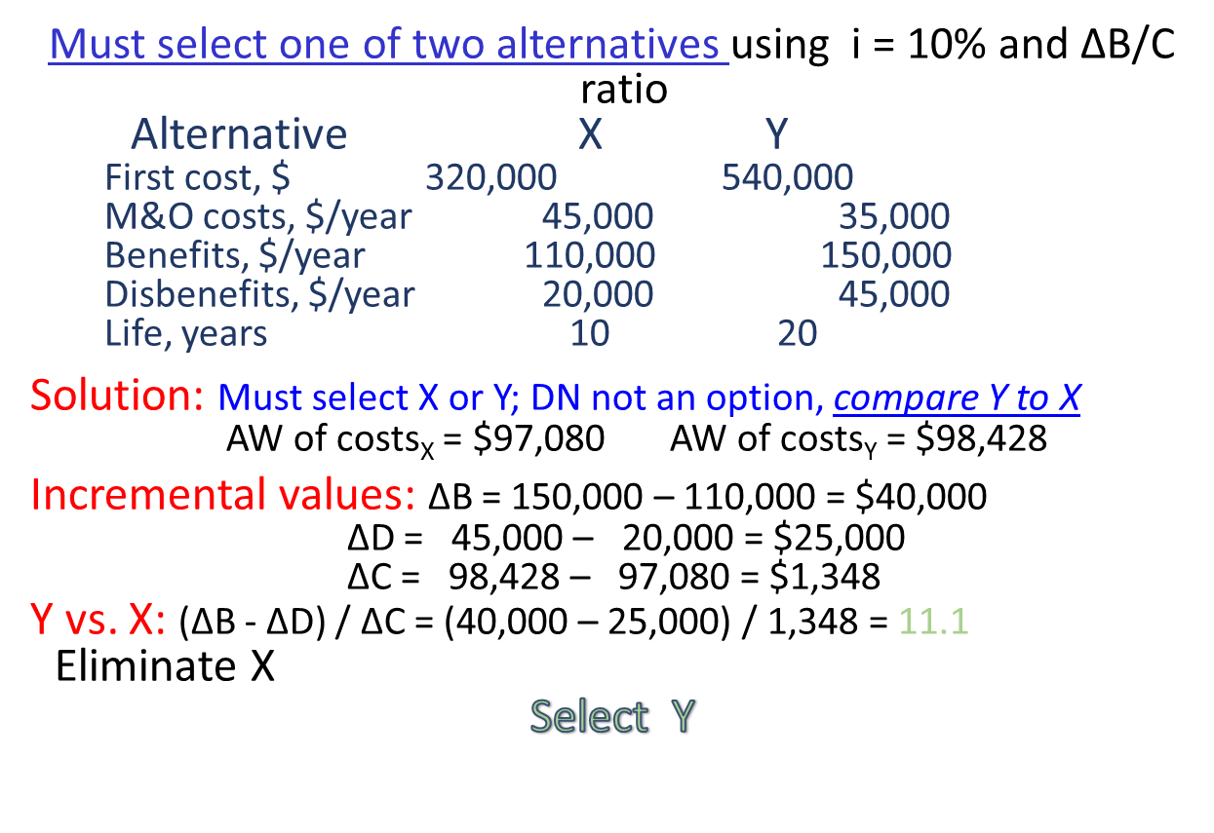
Example: ∆B/C Analysis; Selection Required
9-<number>
© 2012 by McGraw-Hill All Rights Reserved

Slide 24
B/C Analysis of Independent Projects
Independent projects comparison does not require incremental analysis
Compare each alternative’s overall B/C with DN option
No budget limit: Accept all alternatives with B/C ≥ 1.0
Budget limit specified: capital budgeting problem; selection follows different procedure (discussed in chapter 12)
9-<number>
© 2012 by McGraw-Hill All Rights Reserved

Slide 25

Cost Effectiveness Analysis
Service sector projects primarily involve intangibles, not physical facilities; examples include health care, security programs, credit card services, etc.
Cost-effectiveness analysis (CEA) combines monetary cost
estimates with non-monetary benefit estimates to calculate the
Cost-effectiveness ratio (CER)
Equivalent total costs
Total effectiveness measure
= C/E
CER =
© 2012 by McGraw-Hill All Rights Reserved
9-<number>

Slide 26
CER Analysis for Independent Projects
Procedure is as follows:
(1) Determine equivalent total cost C, total effectiveness measure E and CER
(2) Order projects by smallest to largest CER
(3) Determine cumulative cost of projects and compare to budget limit b
(4) Fund all projects such that b is not exceeded
Example: The effectiveness measure E is the number of graduates from adult training programs. For the CERs shown, determine which independent
programs should be selected; b = $500,000.
Program CER, $/graduate Program Cost, $
A 1203 305,000
B 752 98,000
C 2010 126,000
D 1830 365,000
© 2012 by McGraw-Hill All Rights Reserved
9-<number>

Slide 27
Example: CER for Independent Projects
First, rank programs according to increasing CER:
Cumulative
Program CER, $/graduate Program Cost, $ Cost, $
B 752 98,000 98,000
A 1203 305,000 403,000
D 1830 365,000 768,000
C 2010 126,000 894,000
Next, select programs until budget is not exceeded
Select programs B and A at total cost of $403,000
Note: To expend the entire $500,000, accept as many additional individuals as possible from D at the per-student rate
© 2012 by McGraw-Hill All Rights Reserved
9-<number>

Slide 28
CER Analysis for Mutually Exclusive Projects
Procedure is as follows
(1) Order alternatives smallest to largest by effectiveness measure E
Calculate CER for first alternative (defender) and compare to DN option
Calculate incremental cost (∆C), effectiveness (∆E), and incremental measure
∆C/E for challenger (next higher E measure)
If ∆C/E_{challenger} < C/E_{defender} challenger becomes defender (dominance);
otherwise, no dominance is present and both alternatives are retained
(5) Dominance present: Eliminate defender and compare next alternative
to new defender per steps (3) and (4).
Dominance not present: Current challenger becomes new defender against
next challenger, but old defender remains viable
(6) Continue steps (3) through (5) until only 1 alternative remains or only
non-dominated alternatives remain
(7) Apply budget limit or other criteria to determine which of remaining
non-dominated alternatives can be funded
© 2012 by McGraw-Hill All Rights Reserved
9-<number>

Slide 29
Example: CER for ME Service Projects
The effectiveness measure E is wins per person. From the cost and effectiveness values shown, determine which alternative to select.
Cost (C) Effectiveness (E) CER
Program $/person wins/person $/win
A 2200 4 550
B 1400 2 700
C 6860 7 980
© 2012 by McGraw-Hill All Rights Reserved
9-<number>

Slide 30
Example: CER for ME Service Projects
Solution:
Order programs according to increasing effectiveness measure E
Cost (C) Effectiveness (E) CER
Program $/person wins/person $/win
B 1,400 2 700
A 2,200 4 550
  C 6,860 7 980
B vs. DN: C/E_{B} = 1400/2 = 700
A vs. B: ∆C/E = (2200 – 1400)/(4 – 2) = 400 Dominance; eliminate B
C vs. A: ∆C/E = (6860 – 2200)/(7 – 4) = 1553 No dominance; retain C
Must use other criteria to select either A or C
© 2012 by McGraw-Hill All Rights Reserved
9-<number>

Slide 31
Ethical Considerations
Engineers are routinely involved in two areas
where ethics may be compromised:
Public policy making – Development of strategy, e.g., water system management (supply/demand strategy; ground vs. surface sources)
Public planning - Development of projects, e.g., water operations (distribution, rates, sales to outlying areas)
Engineers must maintain integrity and impartiality and
always adhere to Code of Ethics
© 2012 by McGraw-Hill All Rights Reserved
9-<number>

Slide 32
Summary of Important Points
B/C method used in public sector project evaluation
Can use PW, AW, or FW for incremental B/C analysis, but must
be consistent with units for B,C, and D estimates
For multiple mutually exclusive alternatives, compare two at a time
and eliminate alternatives until only one remains
For independent alternatives with no budget limit, compare each against
DN and select all alternatives that have B/C ≥ 1.0
CEA analysis for service sector projects combines cost and
nonmonetary measures
Ethical dilemmas are especially prevalent in public sector projects
© 2012 by McGraw-Hill All Rights Reserved
9-<number>

